Slide 1
Starting and Stopping Services

Slide 2
Several different init systems are in use with Linux systems today
SysVinit
Upstart-Popularized in Ubuntu
Systemd—The latest versions of Fedora and RHEL use the systemd init system.

Slide 3
Understanding the Initialization Daemon (init or systemd)
The Linux kernel has a process ID (PID) of 0.
Thus, the initialization process (init or systemd) daemon has a parent process ID (PPID) of 0, and a PID of 1.
Once started, init is responsible for spawning (launching) processes configured to be started at the server’s boot time, such as the login shell (getty or mingetty process).
It is also responsible for managing services.
# ps -e | head

Slide 4
Understanding the classic init daemons
the older BSD init daemon would obtain configuration information from the /etc/ttytab file.
Now, like the SysVinit daemon, the BSD init daemon’s configuration information is taken at boot time from the /etc/inittab file.

Slide 5
# cat /etc/inittab
# inittab This file describes how the INIT process should set up
# Default runlevel. The runlevels used by RHS are:
# 0 - halt (Do NOT set initdefault to this)
# 1 - Single user mode
# 2 - Multiuser, no NFS (Same as 3, if you do not have networking)
# 3 - Full multiuser mode
# 4 - unused
# 5 - X11
# 6 - reboot (Do NOT set initdefault to this)
#
id:5:initdefault:
……

Slide 6
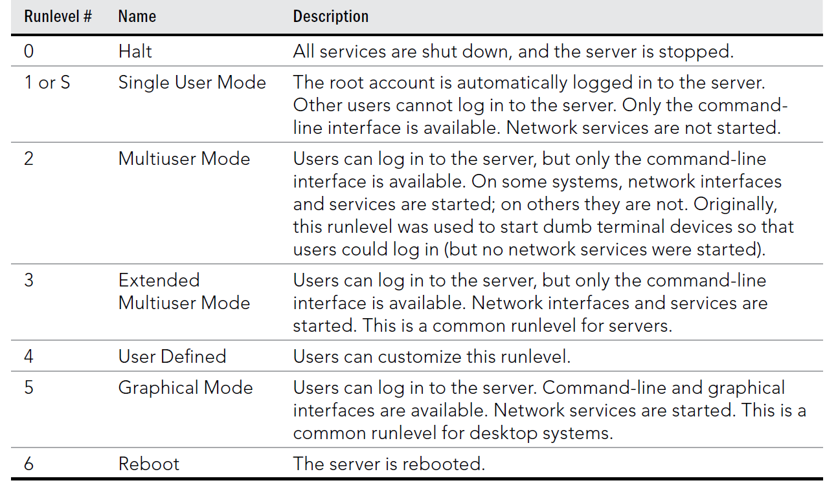

Slide 7
init 3
runlevel
When a runlevel is chosen, the scripts located in the /etc/rc.d/rc#.d
directory (where # is the chosen runlevel) are run.

Slide 8
Understanding systemd initialization
The systemd is also concerned with runlevels, but they are called target units.
Although the main job of systemd is to start services, it can manage other types of things called units. A unit is a group consisting of a name, type, and configuration file and is focused on a particular service or action

Slide 9
Service unit and Target unit
A service unit is for managing daemons on your Linux server.
A target unit is simply a group of other units.
systemctl list-units | grep .service
systemctl list-units | grep .target

Slide 10
Checking the Status of Services
Checking services for SysVinit systems
chkconfig --list
# service --status-all | grep running... | sort
anacron (pid 2162) is running...
atd (pid 2172) is running...
auditd (pid 1653) is running...
automount (pid 1952) is running...
console-kit-daemon (pid 2046) is running...
crond (pid 2118) is running...
cupsd (pid 1988) is running...
...
sshd (pid 2002) is running...
syslogd (pid 1681) is running...
xfs (pid 2151) is running...
yum-updatesd (pid 2205) is running...

Slide 11
# chkconfig --list cups
cups 0:off 1:off 2:on 3:on 4:on 5:on 6:off
#
# service cups status
cupsd (pid 1988) is running...

Slide 12
Checking services for systemd systems
systemctl list-unit-files --type=service | grep -v disabled
systemctl status cups.service

Slide 13
Stopping and Starting Services
Stopping and starting SysVinit services
# service cups stop
# service cups start
# service cups restart
# service cups status
Stopping and starting systemd services
systemctl start cups.service
systemctl restart cups.service
systemctl stop cups.service

Slide 14
Configuring a Default Runlevel or Target Unit
Configuring the SysVinit default runlevel
# cat /etc/inittab
#
# inittab This file describes how the INIT process should
# set up the system in a certain run-level.
...
id:5:initdefault:
...

Slide 15
Traditional runlevel New target name Symbolically linked to… Runlevel 0 | runlevel0.target -> poweroff.target Runlevel 1 | runlevel1.target -> rescue.target Runlevel 2 | runlevel2.target -> multi-user.target Runlevel 3 | runlevel3.target -> multi-user.target Runlevel 4 | runlevel4.target -> multi-user.target Runlevel 5 | runlevel5.target -> graphical.target Runlevel 6 | runlevel6.target -> reboot.target
#systemctl get-default
#systemctl set-default runlevel3.target
#systemctl isolate graphical.target

